Slide 1

Speaking Professor Recognition
BA865 #7
Jiadai Yu, Shu Wang, Yulu Jiang

Slide 2
Table of Contents
01
02
03
04
Overview
Pre-processing
Model
Conclusion
Objective & Motivation
Data Collection & Pre-processing
Performance comparison
Implication & Improvements

Slide 3
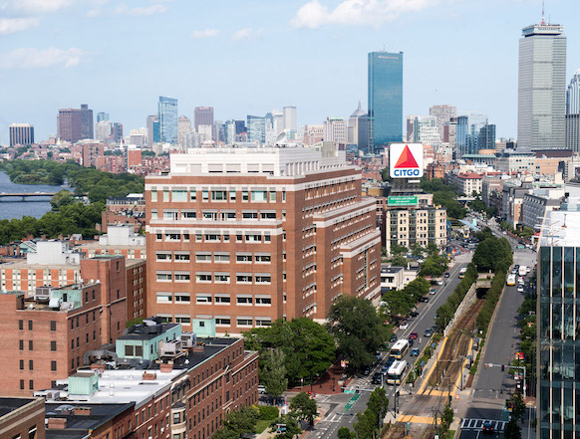
Objective
Recognize QST professor through speaker classification
Motivation
1 Enhance student learning experience
navigate speaking professor
2 New project challenges
audio inputs, new packages
3 High data accessibility
Echo360 lecture recording
Notes:
Provide motivation / backgroundfor the project’s value.

Slide 4

Dataset & Pre-processing
9 classes
Sample audio segment:
BA810
Sahoo
Segment
For each class, ~20 minutes split into ~120 audio pieces
-> 1222 samples in total
BA775/780
Soltanieh-Ha
BA875 Bellamy
…
00:00
00:10
19:40
19:50
20:00
BA830
Fradkin
Per audio piece: 10 seconds
ES710
Hutchinson
Original vector:
[[left_1, right_1],
[left_2, right_2],
…
[left_48k, right_48k]]
BA865
Burtch
…
BA820
Lee
BA860
Lin
Same length,
Different amount of info stored
Downsample
48 kHz -> 8 kHz
ES720 McGinnis
Pooling (LSTM only)
80k -> 4k
Padding
Make sure equal length
Notes:
我们有downsample的audio sample吗
Description of the dataset, i.e., itssource, what it contains. Explanation of pre-processing steps(if necessary)
1222

Slide 5
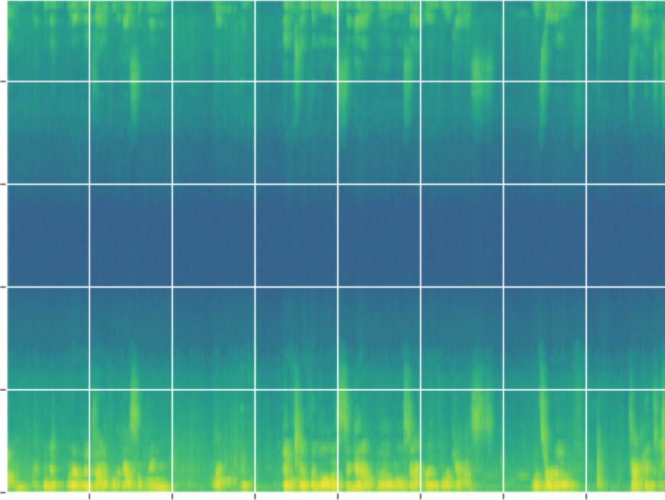
2D CNN Model Preprocessing
Audio Signal Spectrogram
# visualization package
import pylab
# create a spectrogram of an audio signal
pylab.specgram()
Frequency (Hertz)
Time (Second)
Notes:
Except for 2D, different inputs and different preprocessing

Slide 6
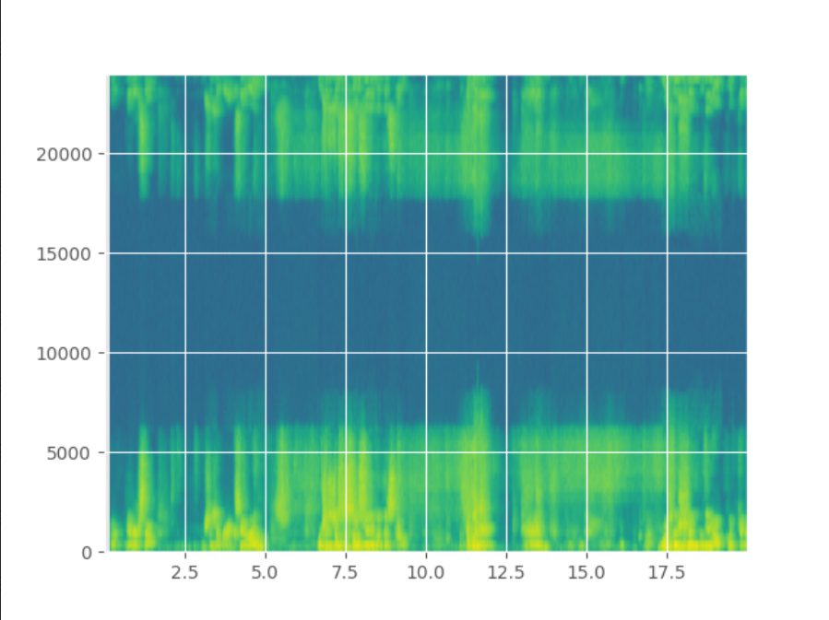
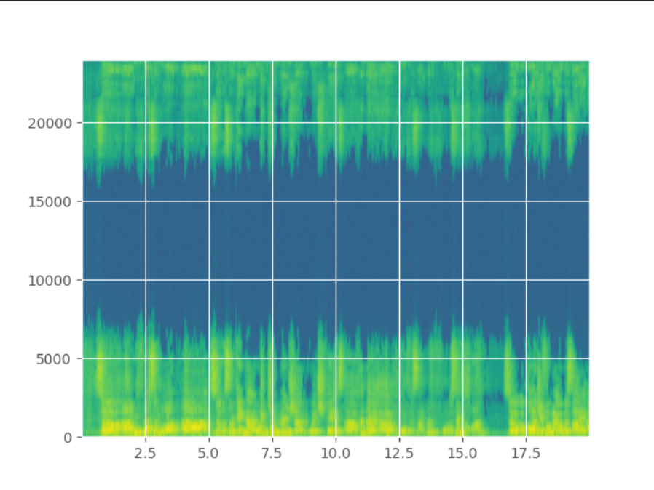
Spectrogram Comparison
Notes:
Female vocal tracts are typically shorter and narrower than male vocal tracts, which means that the sound waves produced by female speakers have higher frequencies and shorter wavelengths. This results in a more concentrated energy distribution in the higher frequency range, making it easier to distinguish between different frequency components.
On the other hand, male vocal tracts are generally longer and wider, resulting in lower frequency sound waves with longer wavelengths. This can lead to a less well-defined border between different frequency components, making it more difficult to distinguish between them.

Slide 7
Takeaways:
Well-defined border for female voice spectrogram
Female vocal tracts are shorter and narrower than male ones.
Higher frequencies and shorter wavelengths.
Professor Burtch
Professor Lin
Notes:
Female vocal tracts are typically shorter and narrower than male vocal tracts, which means that the sound waves produced by female speakers have higher frequencies and shorter wavelengths. This results in a more concentrated energy distribution in the higher frequency range, making it easier to distinguish between different frequency components.
On the other hand, male vocal tracts are generally longer and wider, resulting in lower frequency sound waves with longer wavelengths. This can lead to a less well-defined border between different frequency components, making it more difficult to distinguish between them.

Slide 8
1D CNN Model
Sequence of numbers
Activation function:
ReLu for first/hidden layers;
Softmax for output layer
Loss function and Metrics:
Sparse_categorical_crossentropy;
Sparse_categorical_accuracy
For multiclass-label classification
Structure of 1D CNN:
Conv1D->Max pooling
Conv1D->Average pooling
Flatten->Hidden Layers
Output Layer
Labels:
Give each professor a number from 0-8

Slide 9
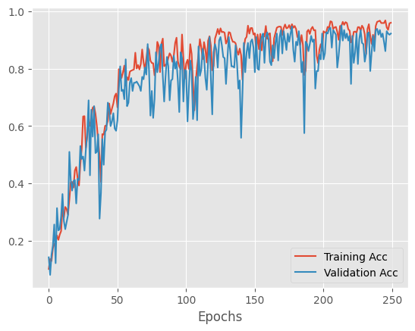
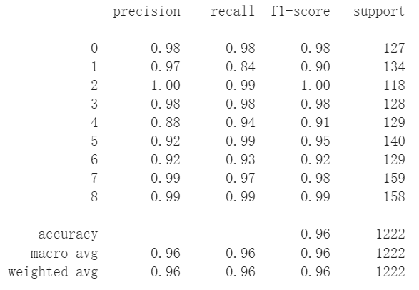
Model Performance

Slide 10
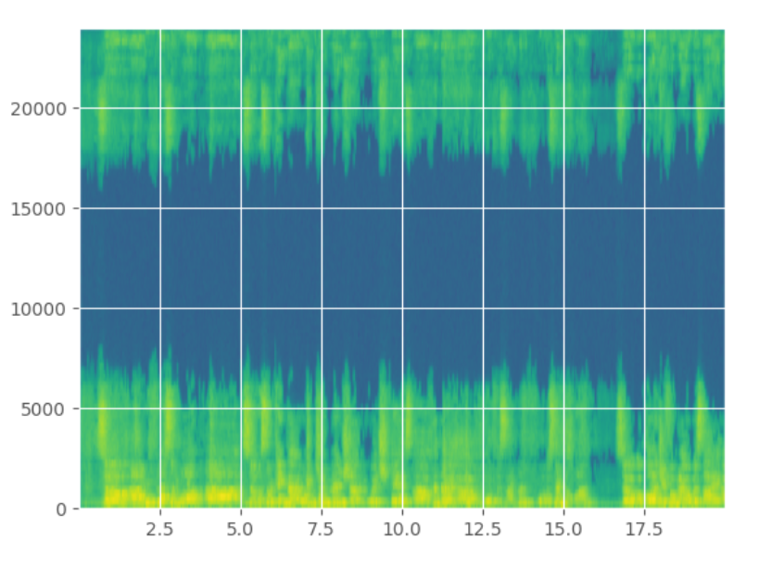
2D CNN Model
Spectrogram
visual representation of the spectrum of frequencies of a signal as it varies with time
Activation/Loss function:
Same as in 1D CNN
For multiclass-label classification
Image Augmentation:
Rescaling, RandomFlip/Rotation
Structure of 2D CNN:
Conv2D->Batch Normalization->Max Pooling 2D->Batch Normalization
Flatten -> Dropout -> Output

Slide 11
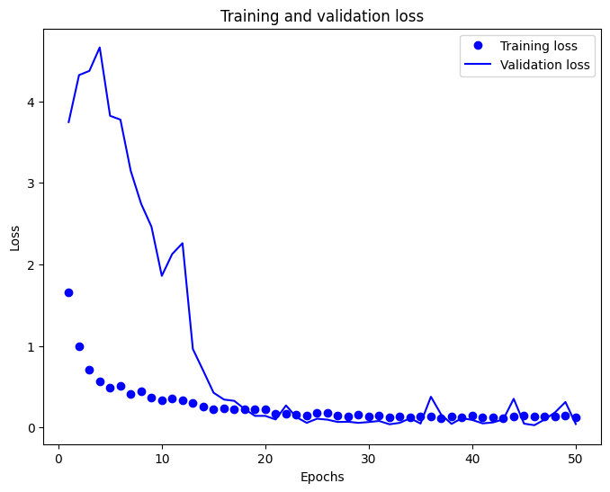
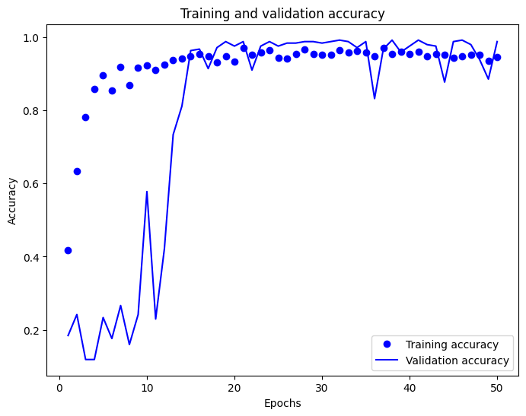
Model Performance

Slide 12
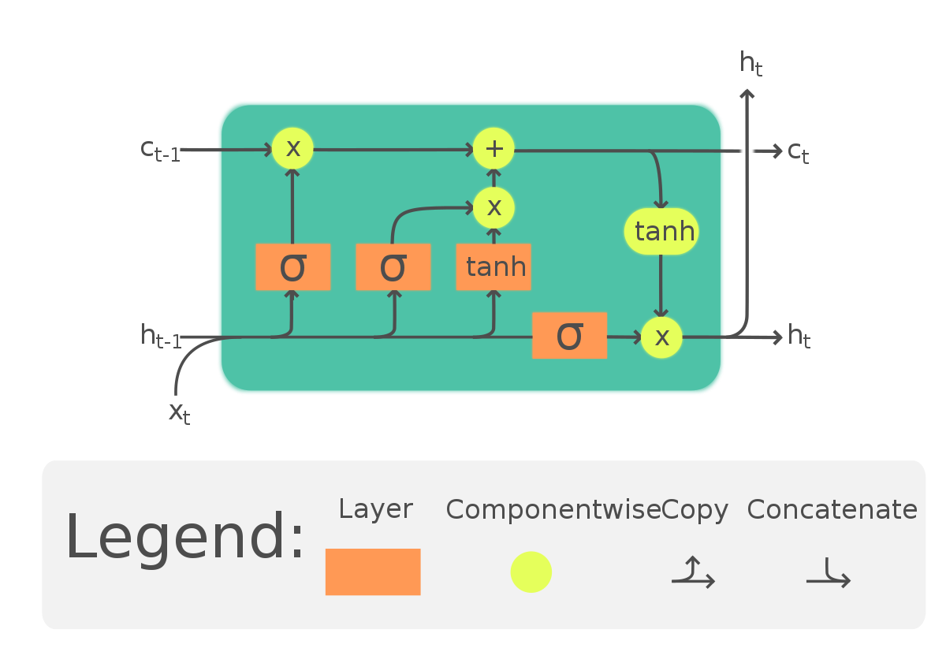
LSTM Model
Activation/Loss function:
Same as in 1D CNN
For multiclass-label classification
Structure of LSTM:
LSTM -> Dropout -> Hidden Layer -> Output Layer

Slide 13
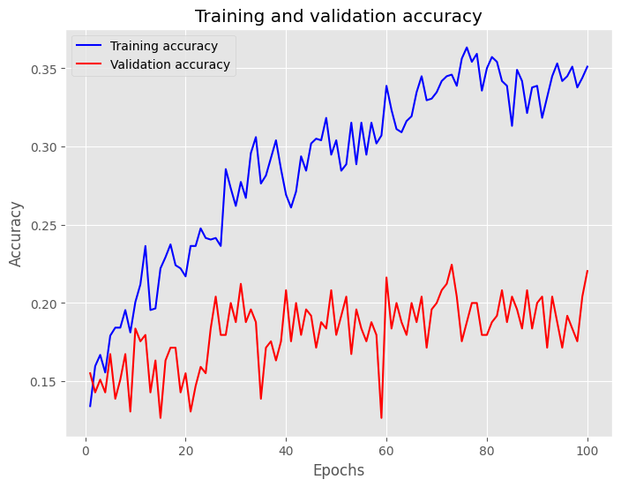
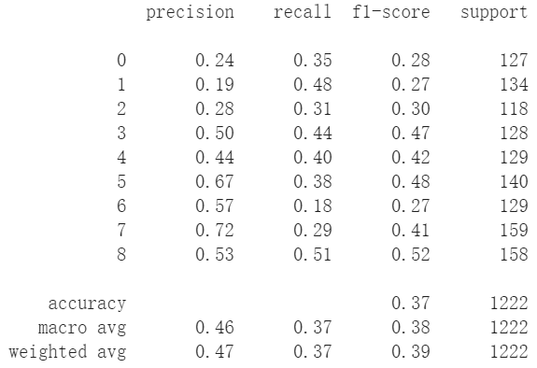
Model Performance

Slide 14

Fine-tuning on 1D CNN
2D CNN takes much longer time to fine-tuning
1D CNN has a more stable performance compared to 2D-CNN
Hyperparameters:
Kernel Size,Dropout Rate,Batch Size
Grid Search results for best model:
Training accuracy -> 95%
Validation accuracy -> 92%
More complex models lead to overfitting

Slide 15
Conclusions
 | 1D CNN | 2D CNN | LSTM
Validation Accuracy
Pros | Efficient, and growing accuracy with fine tuning and more epoches | Good at capturing both local and global dependencies, high accuracy | Simple, easy to use
Cons | Not be as effective for capturing global dependencies in data | Computationally expensive | Low accuracy because of the length of sequences
96%
93%
20%
Notes:
Thanks Alex, so to conclude, the 1D CNN it’s not as effective for capturing global dependencies at the beginning, but it is efficient and the accuracy grows with fine tuning, and the final validation accuracy reaches 96%
The 2D CNN is good at capturing both local and global dependencies, and got a very high accuracy of 90%, but it’s also computationally expensive, we need extra RAM to store the images, and the model training process takes a lot of time
Finally the LSTM model is easy to use, but because of the length of the sequences, the accuracy is low

Slide 16

Implications
Biometrics & Security authentication (voice prints)
Confirm the identity of the speaker
Voice-controlled interfaces
Customized services
Natural language processing
Take the accents or speaking habit of the speaker into consideration, make speech-to-text more accurate
Academic tool
Automatically identify and verify the course to which the recording file belongs, and help to manage the learning materials better
Notes:
Generally speaking, Speaker recognition can be used in various tasks. Firstly, because human voice characteristics are unique to each individual, like fingerprints, an accurate classification model can be used to confirm the identity of the speaker. Thus voice-controlled interfaces will be able to offer more customized services.
And furthermore, with information of the accents or speaking habit of the speaker, the speech-to-text task can be done more accurately, which also helps with NLP
And specifically for our project, this model can automatically identify and verify the speaker of a lecture, which helps with managing the learning materials. For example, now the echo360 recordings are mixture of professors’ speech, Q&A, and sometimes guest speaker. But with speaker recognition, we can mark on the timeline that who is speaking at which point of time, students can easily find the contents he’s most concerned about

Slide 17
Limitations & Improvements
Data collection
The audio files are manually extracted from Echo360, so the efficiency and data size is limited.
Preprocessing
Professor’s speech is mixed with noise, reverberation and classroom discussions of students
Computational power
2D CNN has high accuracy, but GPU quickly ran out of RAM
Network structure
CRNNs, GANs, etc.
Performance evaluation
Precision, recall and robustness
Notes:
Of course, there are many improvements that can make the project better, Firstly is the data collection, cus’ we don’t have access to all the original data on echo 360, the audio files are manually extracted from MSBA courses, which is very inefficient, the size of dataset is limited, and we only got one sample of female professor.
Secondly is the preprocessing, the speech of professor is mixed with noise, reverberation and classroom discussion, our preprocessing couldn’t get rid of all the Interference terms
Thirdly, the GPU quickly ran out of RAM while training the 2D CNN, so we can’t increase the number of epochs
Also we can try more network structure such as CRNNs, and GANs, and use more meatrix to evaluate model performance such as Precision, recall, and robustness

Slide 18
Bonus Speaker Test
Audio misclassified as Mohammad’s voice: FP/(FP+TP) = 0.03
Gordon’s audio being inaccurately classified: FN/(TP+FN) = 0.01
BA810
Sahoo
8.4573139e-06
9.9033117e-01
3.5032605e-05
8.5746113e-04
3.1385373e-04
4.6199220e-05
8.4024193e-03
1.2701168e-08
5.3097924e-06
BA775/780
Soltanieh-Ha
Takeaways:
Similar voice feature across male professors
Limited sample size to identify feature in detail
BA875 Bellamy
BA830
Fradkin
ES710
Hutchinson
BA865
Burtch
BA820
Lee
BA860
Lin
ES720 McGinnis

Slide 19
References
Beigi, H. (2011). Speaker Recognition. In: Fundamentals of Speaker Recognition. Springer, Boston, MA. https://doi.org/10.1007/978-0-387-77592-0_17 [Accessed on: April 25th]
Burtch, G. (2023). Github resource page for BA865. https://github.com/gburtch/BA865-2023 [Accessed on: April 20th]
Ramgire, J. B., & Jagdale, S. M. (2016). A survey on speaker recognition with various feature extraction and classification techniques. International Research Journal of Engineering and Technology, 3(04), 709-712.
Echo360 https://echo360.org/ [Accessed on: April 15th]

Slide 20
Thanks!
Any questions?

